Slide 1
Good Fast Cheap
Tata/ Gun

Slide 2

Sample Constraints
Small dataset: 6513 rows x 14 columns
Test data: 16281 rows x 13 columns

Slide 3
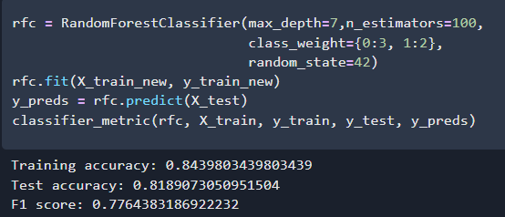
Best Model: Random Forest

Slide 4
Process
EDA
Try multiple models: Logistics, Random Forest, Adaboosting, Neural Network
Hyperparameter tuning
Oversampling: SMOTE, undersampling
Issues
Imbalance Class
Overfitting
Data Leakage -> Wrong Oversampling
Native Nation Dummy: USA vs Non-USA

Slide 5
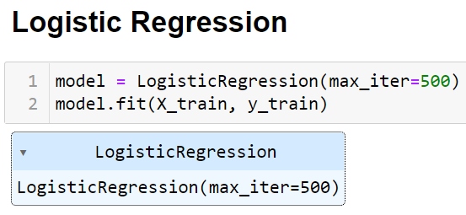
Logistic Regression
Training Score: 0.785
Testing Score: 0.793
F1 Score: 0.43

Slide 6
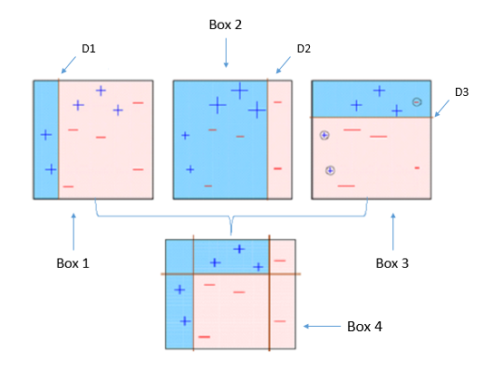
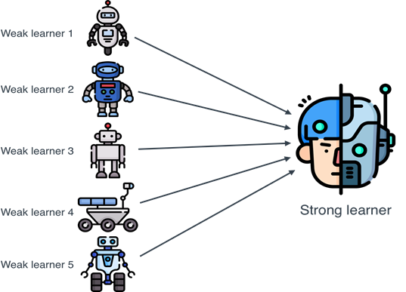
AdaBoost
Training Score: 0.816
Testing Score: 0.803
F1 Score: 0.7666

Slide 7
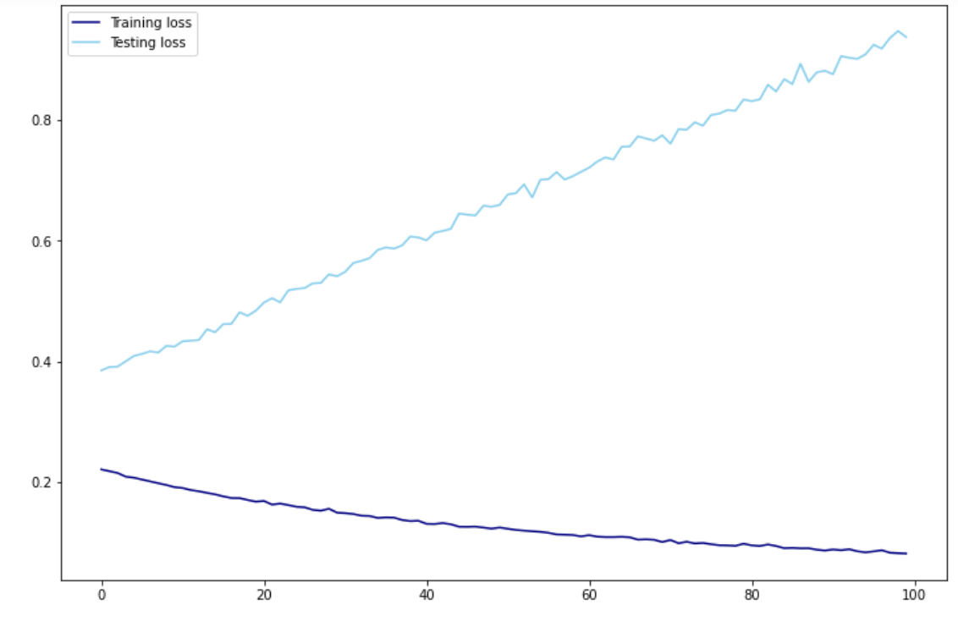
Neural Network
Training and testing score differ by more than 20%.
Time to move on to other models.

Slide 8
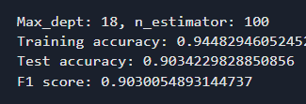


First/Second Submission : Random Forest
Tuning Random Forest
Target: Reduce overfitting
Tuning: Max depth and n_estimators
“DATA LEAKAGE”
Wow! 90% F1 Score
Oversampling Before Split !!

Slide 9
Final Submission : Random Forest
Tuning Random Forest
Target: Reduce overfitting
Tuning: Max depth and n_estimators
Additional of parameter: Class_weight (Because previous model predict too many class 1 (False positive))

Slide 10


Sample constrain
Using simple model: Random Forest
Oversampling “Correctly”
Handling overfit: Reduce max depth of the random forest
~ 82% f1 score
Submission to check the score
Pray

Slide 11
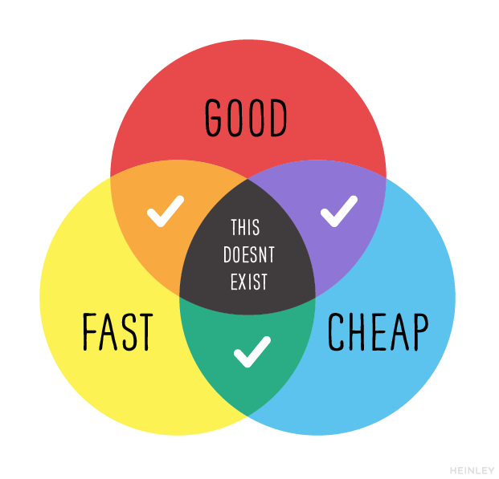

Slide 12


